Slide 1
CyberSkills2Work The National Cybersecurity Workforce Development Program

Slide 2
Industrial Control Systems Security
Acknowledgement
This program is funded by the National Security Agency National Centers of Academic Excellence in Cybersecurity (NCAE-C) Program.
For additional information, please visit www.CyberSkills2Work.org.
Course Title
CRN
©2024 CyberSkills2Work - Institution Name

Slide 3
Module 01 – ICS Foundations
Overview
Learn about the differences between ICS and traditional IT systems.
Introduction to the Purdue Reference Architecture.
Explore key topics like SCADA, DCS, and PLCs.
Examine how ICS integrates with physical processes.
Set up Labshock for ICS.
Set up user accounts for CISA ICS certifications.
Course Title
CRN
©2021 CyberSkills2Work - Institution Name

Slide 4
Module 01 – ICS Foundations
What are Industrial Control Systems
ICS refers to integrated systems combining computers, electrical/mechanical devices, and human oversight to automate and control industrial processes.
Commonly used in sectors like manufacturing, power generation, water treatment, and transportation.
Course Title
CRN
©2021 CyberSkills2Work - Institution Name
Notes:
Instructor Talking Points:
Begin by defining ICS: these are systems that use a combination of hardware, software, and human interaction to monitor and control physical processes.
Highlight real-world examples like power grids, manufacturing plants, water treatment facilities, oil pipelines, and transportation networks.
Emphasize the distinction between fully automated and semi-automated systems: not all ICS are autonomous; many rely on human oversight via HMIs.
Key Concepts to Convey:
Industrial Control Systems (ICS) are automated systems that monitor and control industrial processes. These systems are used in sectors like electricity, oil & gas, water, chemicals, and manufacturing.
The purpose of ICS is to improve efficiency, safety, and precision by reducing human error and enabling remote supervision and control.
Explanation for Non-Experts:
Think of ICS as the “brains and nerves” of a power plant, water facility, or factory. Instead of people flipping switches and turning knobs, ICS use software and controllers to run machines automatically.
Example Analogy:
Just as a smart thermostat controls your home’s temperature automatically, ICS control temperature, flow, pressure, and other physical variables in large industrial operations—but on a much bigger scale.
Class Discussion Prompt:
Ask students: “Can you name industries or specific systems that depend on ICS in your city or region?”

Slide 5
Module 01 – ICS Foundations
ICS vs Traditional IT Systems
ICS integrates deeply with physical processes, requiring high reliability and real-time operations.
Unlike IT, ICS prioritizes availability and safety over confidentiality and integrity.
*ICS systems often operate with legacy hardware and limited computing resources.
Course Title
CRN
©2021 CyberSkills2Work - Institution Name
Notes:
Instructor Talking Points:
Discuss fundamental differences:
ICS prioritizes availability and deterministic response times over data confidentiality.
ICS systems are often deployed for 10–30 years without major hardware refreshes.
ICS must interface with physical equipment—pumps, turbines, valves—which introduces unique safety and timing concerns.
Highlight operational constraints like unpatchable systems, proprietary protocols, and custom hardware.
For Instructors New to ICS:
Explain that IT security concerns revolve around data protection (e.g., emails, databases), whereas ICS security is about ensuring pumps don’t explode, grids don’t go down, and water doesn’t overflow due to malicious commands.
Interactive Activity:
Have students list and compare security priorities in an ICS vs. a corporate IT setting.

Slide 6
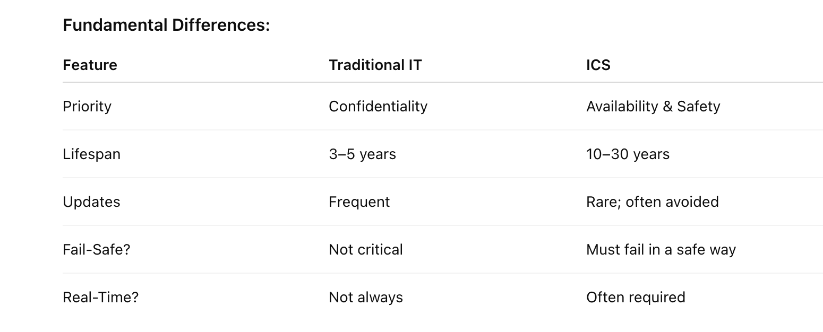
Module 01 – ICS Foundations
ICS vs Traditional IT Systems - Table
Course Title
CRN
©2021 CyberSkills2Work - Institution Name
Notes:
The table above is self-explanatory, but it would be helpful to have students discuss why some of these differences exist between ICS and traditional IT systems.

Slide 7
Module 01 – ICS Foundations
Key Components in ICS
Programmable Logic Controllers (PLCs) – Manage control tasks at the field level.
Remote Terminal Units (RTUs) – Interface with field devices and communicate with central systems.
Human-Machine Interfaces (HMIs) – Provide visualization and operator control of processes.
Supervisory Control and Data Acquisition (SCADA) – Centralized systems managing geographically dispersed operations. Note: This is a software-based program.
Distributed Control Systems (DCS) – Manage complex, localized processes in manufacturing or refining environments. Also a software based program.
Course Title
CRN
©2021 CyberSkills2Work - Institution Name
Notes:
Breakdown of Components (use visuals if possible):
PLCs (Programmable Logic Controllers): Small rugged computers designed to run repetitive tasks like opening/closing valves or activating alarms.
RTUs (Remote Terminal Units): Similar to PLCs but typically used over long distances and often equipped with communication capabilities.
HMIs (Human-Machine Interfaces): The digital dashboards operators use to monitor real-time process status (e.g., tank levels, motor speeds).
SCADA Systems: These are “supervisory” platforms that collect data from many PLCs/RTUs and allow operators to control processes from a central location.
DCS (Distributed Control Systems): Used in plants with many interconnected processes (like chemical plants); unlike SCADA, DCS handles more automatic control internally.
Instructor Tip:
Emphasize that ICS systems are not isolated devices but rather a network of computers, controllers, and sensors working together to manage physical processes.
Visual Aid:
Show a diagram mapping components to typical ICS network architecture.

Slide 8
Module 01 – ICS Foundations
SCADA (Supervisory Control and Data Acquisition
SCADA is a system of software and hardware elements used to monitor and control geographically distributed systems in real-time. Common in industries like water treatment, power transmission, oil & gas pipelines. Used to identify and react to alarms.
Components:
RTUs and PLCs at remote sites collect data and execute control commands.
SCADA Master Terminal Unit (MTU) aggregates data at a central control center.
HMIs allow operators to visualize and control operations.
Communication via serial, wireless, or TCP/IP over wide-area networks (WAN).
Designed for intermittent or unreliable communication conditions.
Provides centralized monitoring, alarm handling, data trending, and historian functions.
Course Title
CRN
©2021 CyberSkills2Work - Institution Name
Notes:
Definition and Purpose:
SCADA stands for Supervisory Control and Data Acquisition. It's a category of ICS software and hardware used primarily to monitor and control infrastructure systems that are geographically dispersed.
These systems typically do not operate in a closed loop. Instead, they focus on data acquisition, alarm management, and high-level supervisory control.
A Very important component of a SCADA system is the ability to identify and react to alarms.
Key Components and Roles:
RTUs (Remote Terminal Units): Devices installed in remote locations (e.g., substations, pump stations) to collect telemetry data (voltage, pressure, flow) and relay commands.
PLCs (Programmable Logic Controllers): Sometimes used instead of RTUs for automation in smaller or local settings; more customizable for logic-based control.
MTU (Master Terminal Unit): The central SCADA server that communicates with multiple RTUs/PLCs.
HMIs (Human-Machine Interfaces): Provide visual dashboards for operators to monitor and issue manual commands.
Industry Use Cases:
Power grid substations across hundreds of miles.
Water distribution and sewer systems for municipalities.
Oil and gas pipelines that span regions or countries.
Communication Focus:
Because SCADA often operates over wide-area networks (WAN), communication links may be unreliable or bandwidth-limited.
SCADA protocols like DNP3, Modbus RTU/TCP, and IEC 60870-5-104 are designed with latency tolerance and prioritization.
Teaching Emphasis:
Highlight SCADA’s focus on supervision and monitoring, not the actual automation process itself. SCADA doesn’t perform continuous real-time process control.
Show the distinction between centralized control (SCADA) and distributed automation (DCS), which leads into the next slide.

Slide 9
Module 01 – ICS Foundations
DCS (Distributed Control System)
DCS is used for continuous, complex, and high-speed process control in localized environments.
Common in industries like chemical plants, oil refineries, paper mills, and power generation. DCS is more localized than SCADA.
Components:
Controllers handle real-time process automation at different plant sections.
Process Control Network (PCN) connects field devices, controllers, and HMIs.
Engineering Workstations configure control logic and manage alarms/events.
Designed for high availability, fault tolerance, and precision.
All elements reside within a tightly integrated network—typically LAN-based.
Course Title
CRN
©2021 CyberSkills2Work - Institution Name
Notes:
Definition and Purpose:
DCS (Distributed Control System) is an ICS architecture tailored for localized, continuous process control.
DCS automates and controls process variables such as temperature, pressure, flow, and chemical reactions in real time, within a central facility.
Key Components and Architecture:
Field Controllers (also called process controllers): Deployed across various areas of the plant. Each controller is responsible for a process unit (e.g., a reactor, distillation column).
HMIs: Operators view process states and issue overrides if necessary. Unlike SCADA, control logic is embedded in local DCS controllers—not just in the HMI or central server.
Engineering Workstations: Allow engineers to configure control strategies, tune PID loops, and deploy new logic.
Redundant Networks: DCS architectures often include redundant control buses and backup controllers for high availability.
Industry Use Cases:
Oil refineries managing chemical reactions across dozens of process units.
Pharmaceutical manufacturing with precise temperature and humidity requirements.
Nuclear and fossil fuel power plants for turbine and boiler management.

Slide 10
Module 01 – ICS Foundations
Differences Between SCADA and DCS - Videos
https://www.dpstele.com/blog/similarities-and-differences-between-scada-and-dcs.php#:~:text=The%20Bottom%20Line,operational%20needs%20and%20network%20configuration.
https://www.youtube.com/watch?v=B3YVpgs9RY4
https://youtu.be/X0U8-4ZPcro
Course Title
CRN
©2021 CyberSkills2Work - Institution Name
Notes:
Link to YouTube video that describes some key differences between SCADA and DCS.

Slide 11
Module 01 – ICS Foundations
ICS Architectures and Zones
Enterprise Zone – Business/IT networks; often internet-connected and more dynamic.
Control Zone – Includes SCADA servers, control rooms; focused on stability and precision.
Field Zone – Hosts real-time control devices like PLCs; stringent on timing, safety, and determinism.
Importance of Segmentation:
Supports defense-in-depth strategies.
Helps isolate cyber threats and apply tailored security policies per zone.
Course Title
CRN
©2021 CyberSkills2Work - Institution Name
Notes:
Instructor Talking Points:
Introduce the three-zone ICS model from Chapter 1 of the textbook:
Enterprise Zone: Traditional IT zone—email, billing, databases. Often connected to the internet.
Control Zone: Includes SCADA servers, engineering workstations, and control rooms. Interfaces between business systems and field devices.
Field Zone: Physical layer with PLCs and sensors. Tight timing, high reliability, often lacking IT-grade cybersecurity.
Stress the importance of segmentation for both performance and security.
How This Helps:
This layered structure is meant to separate general business functions from real-time control functions for safety and security.
Use this analogy:
Think of a hospital: the billing office (enterprise) shouldn’t interfere with the operating room (field zone). If malware shuts down billing, the patient is safe. If malware shuts down a ventilator, it’s catastrophic.
Example Discussion:
Explore how a malware infection might move from the Enterprise zone to Field zone, referencing real attacks like Stuxnet.

Slide 12
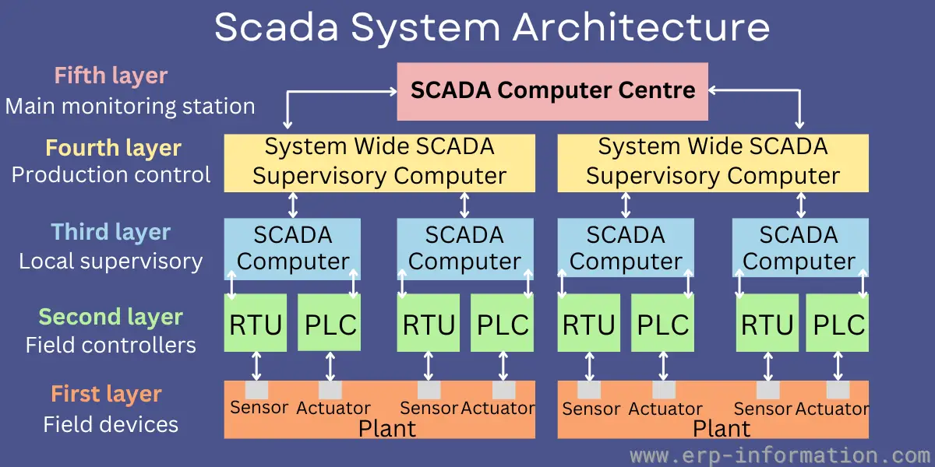
Module 01 – ICS Foundations
Course Title
CRN
©2021 CyberSkills2Work - Institution Name
Notes:
This image illustrates a five-layer hierarchical architecture of a SCADA (Supervisory Control and Data Acquisition) system, which is commonly used in industrial control environments to manage distributed operations across large physical areas.
Layered Breakdown:
First Layer – Field Devices
Components: Sensors and actuators.
Function: These are physical devices installed in the plant that detect process variables (temperature, pressure, flow, etc.) and perform actions (opening valves, starting motors).
Second Layer – Field Controllers
Components: RTUs (Remote Terminal Units) and PLCs (Programmable Logic Controllers).
Function: These controllers receive data from sensors and send commands to actuators. They are responsible for real-time automation and process execution.
Third Layer – Local Supervisory
Components: SCADA Computers.
Function: Provide local supervision, interface with PLCs/RTUs, and relay data upward to centralized supervisory systems. Often includes HMI (Human Machine Interface) functionality for local operators.
Fourth Layer – Production Control
Components: System-Wide SCADA Supervisory Computers.
Function: Central supervisory control managing multiple local SCADA computers. Responsible for production-level process oversight, alarms, logging, and visualization.
Fifth Layer – Main Monitoring Station
Component: SCADA Computer Centre.
Function: Enterprise-wide or command-level monitoring hub. It collects data from multiple supervisory computers and provides a comprehensive view of the entire control system across all locations.
🔄 Communication Flow:
Bottom-Up: Data from sensors is transmitted upward through controllers to SCADA computers and central monitoring stations.
Top-Down: Commands, setpoints, and configuration data flow downward from the SCADA center to the plant devices.
📚 Use Case:
This architecture is commonly applied in utility networks, oil & gas pipelines, power grids, and water treatment facilities, enabling reliable and scalable monitoring of geographically dispersed assets.

Slide 13
Module 01 – ICS Foundations
Purdue Reference Architecture
A widely adopted model that layers ICS networks into levels:
Level 5 – Enterprise Network
Level 4 – Site Business Planning & Logistics
Level 3 – Site Operations and Supervisory Control
Level 2 – Area Control
Level 1 – Basic Control (e.g., PLCs)
Level 0 – Physical Process (e.g., valves, sensors)
Course Title
CRN
©2021 CyberSkills2Work - Institution Name
Notes:
Explanation for New Instructors:
This is a conceptual model showing how ICS systems are layered from top (business IT) to bottom (physical process).
It consists of 6 levels:
Level 0: Sensors, actuators
Level 1: PLCs and other control devices
Level 2: Operator control (HMIs, local servers)
Level 3: Plant-wide supervisory control (SCADA, historians)
Level 4: Site IT systems (logistics, planning)
Level 5: Enterprise IT (email, finance, HR)
Purpose of Model:
Helps design secure networks by segmenting zones and placing firewalls/data diodes where appropriate.
Example Discussion:
Ask students: “Why would it be dangerous for an employee’s email to be on the same network as PLCs?”

Slide 14
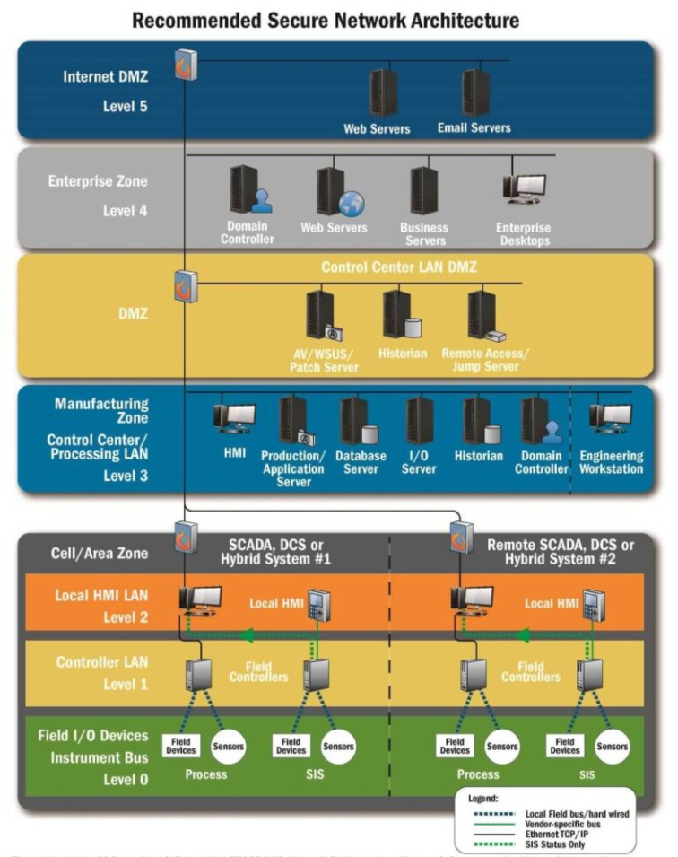
Course Title
CRN
©2021 CyberSkills2Work - Institution Name
Notes:
This diagram illustrates a layered and segmented network architecture commonly recommended for securing Industrial Control Systems (ICS). It integrates both IT (Information Technology) and OT (Operational Technology) components and aligns with the Purdue Reference Model, which is widely used in ICS security planning.
Layered Architecture Overview (Top to Bottom):
Level 5 – Internet DMZ (Demilitarized Zone)
Purpose: Isolate publicly accessible services from internal networks.
Components:
Web servers
Email servers
Security Focus: Firewalls restrict inbound/outbound internet access; no direct connectivity to lower ICS layers.
Level 4 – Enterprise Zone (Corporate IT)
Purpose: Manages business functions such as administration, HR, and finance.
Components:
Domain controllers
Web & business servers
Enterprise desktops
Security Focus: Typically connected to the internet but segmented from control systems. High use of antivirus, patch management, and user authentication.
DMZ – Control Center LAN DMZ
Purpose: Acts as a buffer between enterprise IT and control systems to prevent lateral movement of threats.
Components:
AV / Patch servers
Historian (data storage for operational logs)
Remote access / jump servers
Security Focus: Carefully controlled access, minimal trust; often monitored by firewalls or data diodes.
Level 3 – Manufacturing Zone (Control Center / Processing LAN)
Purpose: Centralized control of plant operations.
Components:
HMI (operator interface)
Application, database, I/O servers
Domain controllers & engineering workstations
Security Focus: Connects to field devices indirectly; systems must be highly reliable and are often running real-time OSes.
Level 2 – Cell / Area Zone (Local HMI LAN)
Purpose: Localized visualization and control within a specific production cell or zone.
Components:
Local HMIs
Security Focus: Directly connected to controllers; requires controlled access from Level 3 only.
Level 1 – Controller LAN
Purpose: Executes real-time control functions.
Components:
PLCs and RTUs (field controllers)
Security Focus: Real-time deterministic performance is prioritized. Devices are highly sensitive to downtime and patching is often delayed.
Level 0 – Field Devices / I/O (Process Interface)
Purpose: Physical process interaction layer.
Components:
Sensors, actuators, pumps, motors
Security Focus: Devices often have no built-in security. Integrity depends on the protection of upper-level controllers.
Communication Paths (Legend):
Green Dashed Lines: Local fieldbus (hardwired)
Orange Dashed Lines: Vendor-specific communication
Black Dashed Lines: Ethernet TCP/IP
Solid Green: SIS (Safety Instrumented Systems) – for status-only communication, isolated from control
Security Principles Illustrated:
Segmentation: Prevents attackers from moving laterally between business and operational environments.
Defense in Depth: Multiple firewalls, zones, and controls reduce risk.
Minimal Exposure: Internet-facing services are isolated at the top level, away from critical physical processes.

Slide 15
Module 01 – ICS Foundations
ICS in Critical Infrastructure
Operational Significance:
ICS underpins sectors defined as critical infrastructure: energy, water, transportation, etc.
A failure or cyberattack on ICS can cause cascading failures and national disruptions.
Integration with Physical Processes:
ICS systems directly control valves, actuators, motors, and sensors.
The cyber-physical nature creates complex dependencies and attack surfaces.
Course Title
CRN
©2021 CyberSkills2Work - Institution Name
Notes:
Instructor Talking Points:
Define critical infrastructure (CI) per DHS and NIST: systems essential to national security, public health, and economic stability.
Discuss ICS roles in:
Energy (generation, transmission, smart grid)
Water and wastewater
Transportation systems (train switches, traffic control)
Food/agriculture (automated processing)
Underscore interdependencies—failure in one sector can cascade into others.
Instructor Context:
Explain that these systems are interdependent. If one sector (e.g., electricity) is attacked, others (e.g., water pumps) may also fail.
Example Scenario:
If a ransomware attack disables the water treatment SCADA system in a city, not only could citizens lose access to clean water, but hospitals and firefighting systems could be impacted.
Case Example:
Northeast U.S. Blackout (2003) and the role SCADA visibility loss played in the outage.

Slide 16
Module 01 – ICS Foundations
ICS Challenges: Security, Safety, and Reliability
Safety and Reliability:
ICS designs emphasize fault tolerance: fault avoidance, fault removal, and fault tolerance.
Systems often operate with redundancy and must respond safely to hardware or software faults.
Cybersecurity Concerns:
ICS devices may be outdated and lack basic cyber protections (e.g., encryption, authentication).
Legacy systems can be vulnerable due to:
Infrequent patching.
Proprietary protocols.
Lack of endpoint security support.
Course Title
CRN
©2021 CyberSkills2Work - Institution Name
Notes:
Instructor Talking Points:
Expand on the triad of operational goals in ICS:
Safety: Prevent harm to people and the environment.
Reliability: Systems must run 24/7 with high availability.
Cybersecurity: Only recently prioritized after events like Stuxnet.
Introduce fault tolerance strategies:
Fault avoidance (design quality)
Fault removal (testing, updates)
Fault tolerance (redundancy, fail-safe modes)
Explain how malware in ICS can result in real-world damage, not just data loss.
For New Instructors:
Stress that traditional patching and antivirus tools aren’t always viable in ICS.
You can’t simply reboot a nuclear reactor or pause a manufacturing line to install updates.
Discussion Prompt:
“Why do you think ICS were traditionally so poorly secured compared to IT systems?”

Slide 17
Module 01 – ICS Foundations
Setting up Labshock – Instructor Led Hands-on Tutorial
https://labshock.github.io/
Course Title
CRN
©2021 CyberSkills2Work - Institution Name
Notes:
Instructor:
Guide the students on how to setup Labshock for their respective OS.
Run them through one of the demo scenarios and discuss the interplay between the various items in the ICS environment.

Slide 18
Module 01 – ICS Foundations
Introduction to CISA’s ICS Certification Path
https://www.cisa.gov/resources-tools/training/ics-virtual-learning-portal
Course Title
CRN
©2021 CyberSkills2Work - Institution Name
Notes:
Instructor:
Guide the students on how to setup their CISA ICS user accounts
Students should complete module 100W in this first week of the bootcamp.

